Slide 1

SMART CAMPUS
Submitted by
Name of the Student:- Keshav Bhardwaj
University Roll Number:- 1900290120051
Under the Supervision of
Name of the Guide:- Prof. Zatin Gupta
Designation:- Assistant Professor

Slide 2
ABSTARCT
Smart automation of appliances is a key factor that plays a major role in easing the human life and controlling appliances like light, fan etc through portable device .it includes not only controlling appliances but also making appliances intelligent to work accordingly to the situation
Zigbee is a wireless technology developed as an open global standard to address the unique needs of low-cost, low-power wireless IoT networks
In order to send command to from app we need internet connection at one node to establish communication between node and app

Slide 3
TABLE OF CONTENTS
Introduction
Problem Statement
Scope
LITERATURE REVIEW
PROPOSED METHODOLOGY
Flowchart
Algorithm Proposed

Slide 4
About the Zigbee 3.0 Protocol
The Zigbee 3.0 protocol was created and ratified by member companies of the Zigbee Alliance Zigbee is a wireless technology developed as an open global standard to address the unique needs of low-cost, low-power wireless IoT networks. The Zigbee standard operates on the IEEE 802.15.4 physical radio specification and operates in unlicensed bands including 2.4 GHz, 900 MHz and 868 MHz.
Zigbee protocol features include:
Support for multiple network topologies such as point-to-point,
point-to-multipoint and mesh networks
Low duty cycle – provides long battery life
Low latency
Direct Sequence Spread Spectrum (DSSS)Up to 65,000 nodes per network
128-bit AES encryption for secure data connections
Collision avoidance, retries and acknowledgements
CONFIGURE ZIGBEE MODULES

Slide 5

The Zigbee Advantage
The Zigbee 3.0 protocol is designed to communicate data through noisy RF environments that are common in commercial and industrial applications

Slide 6
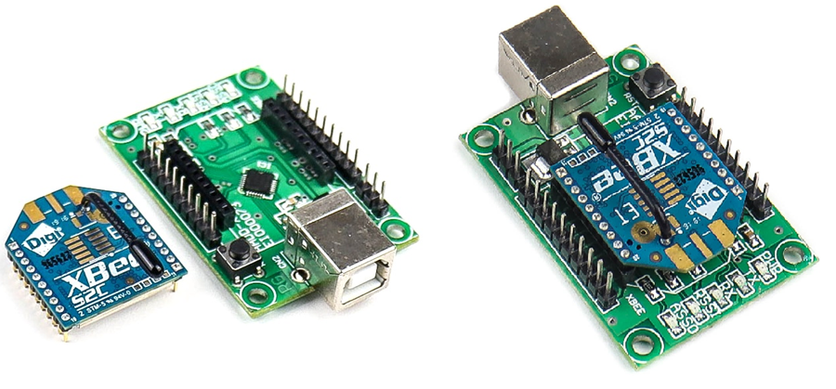
How to configure ZigBee/Xbee Pro
Place the XBee module on XBee USB adapter:

Slide 7

2. Download and Install XCTU software 6.1.1 software
Open XCTU software 6.1.1 software. Click on the search button of XCTU. It directs the XBee connected to the USB adapter. Let us start the configuration of the XBee module.
Open the XCTU software& then click on the search on the top.
To know the com port where radios are connected open the device manager and note down the com port. Select the ports and click on next.
Leave the port parameters to default. (i.e. 9600-8-N-1)
9600- Baud rate
8- Data bit
Parity- None and 1- stop bit
The radios (XBees) are discovered by XCTU& click on Add selected device to see the XBee listed on the left side of the XCTU.

Slide 8
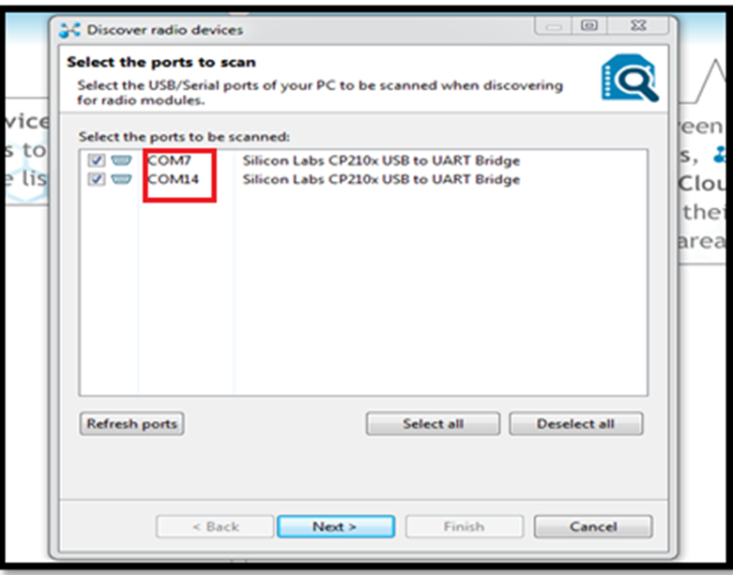
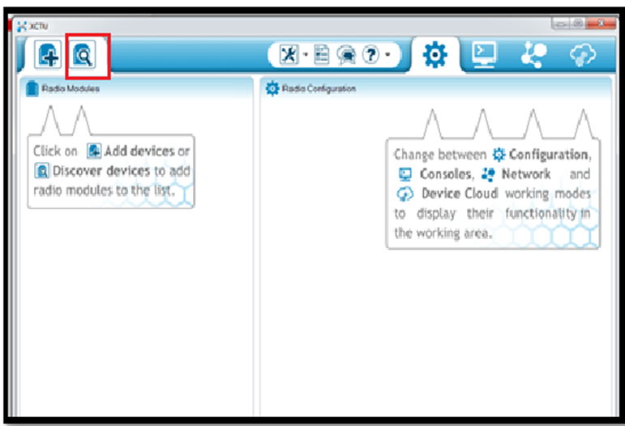

Slide 9
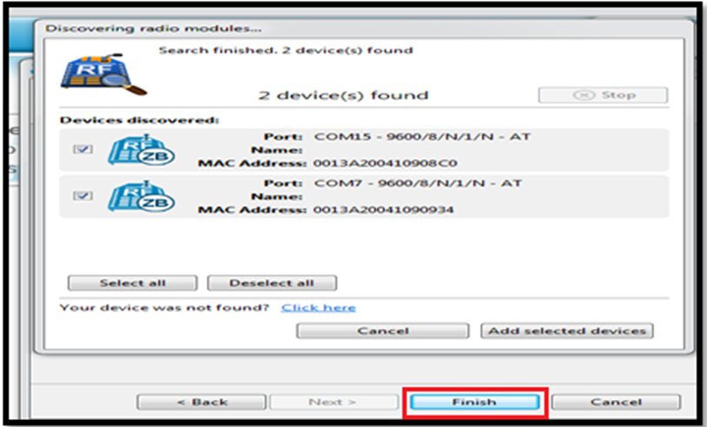

Slide 10

configure the first radio as COORDINATOR
First set Pan ID for your network. This can be any Hex value from 0 to FFFF. (Set it as 1234)
To operate the Radio in the broadcast mode set the DL (Destination address) as FFFF. Type the name of the first radio in NI (Node Identifier). You can provide any name. Here the NI set as COORDINATOR.
To make the Radio as COORDINATOR, Set the CE parameter to Enable and click on the Write button (Pencil Icon) to save the information.

Slide 11
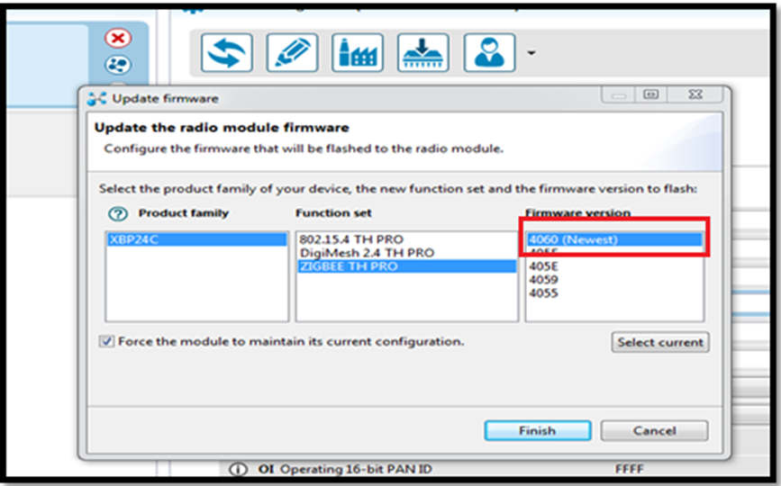
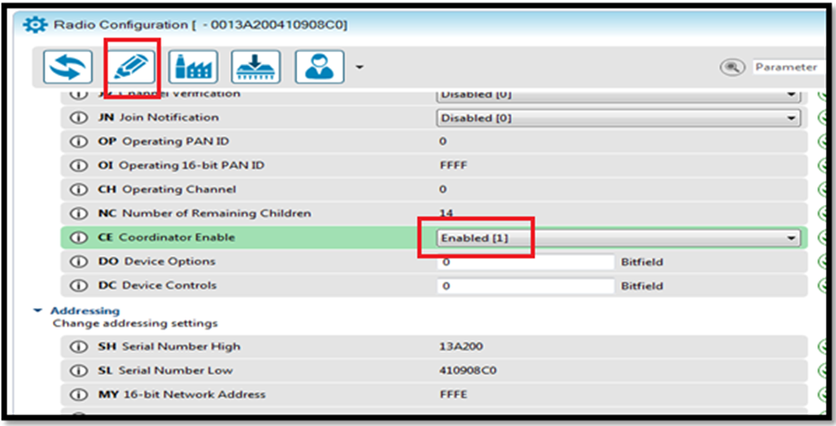

Slide 12
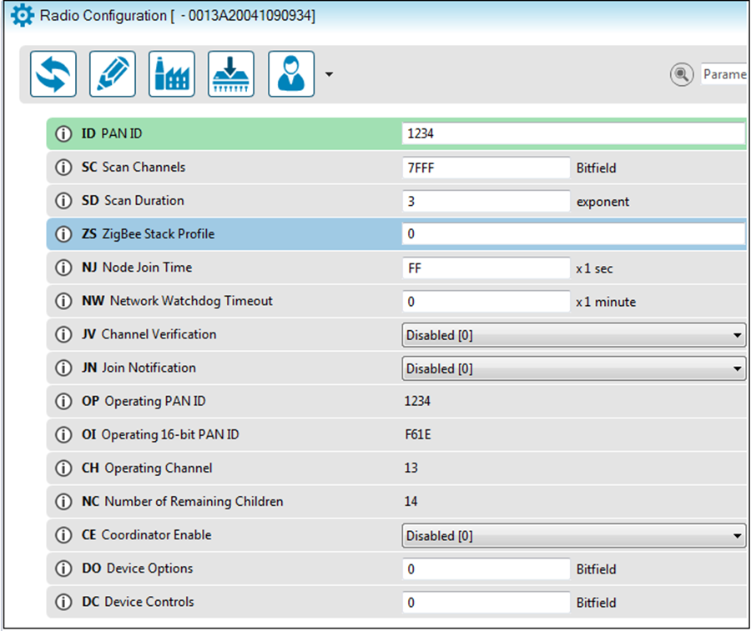
Second Radio - configure as ROUTER
Enter the Pan Id as 1234 which is the same as COORDINATOR. Set the JV channel Verification to enable so that it joins the COORDINATOR. Leave the CE to Disable and click on the Write to save the changes.

Slide 13
Communication between Coordinator and Router
The Radios are configured, now you can do the communication between the COORDINATOR and Router
Now the new window has a ROUTER and the old window has a COORDINATOR

Slide 14
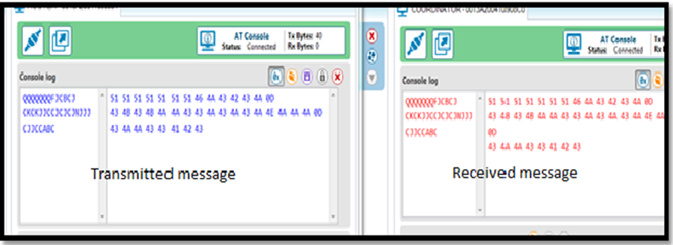

Slide 15
ESTABLISH SETUP BETWEEN ZIGBEE AND ARDUINO
Once your XBee is configured, you can connect it to the Arduino via the breakout/Explorer board

Slide 16
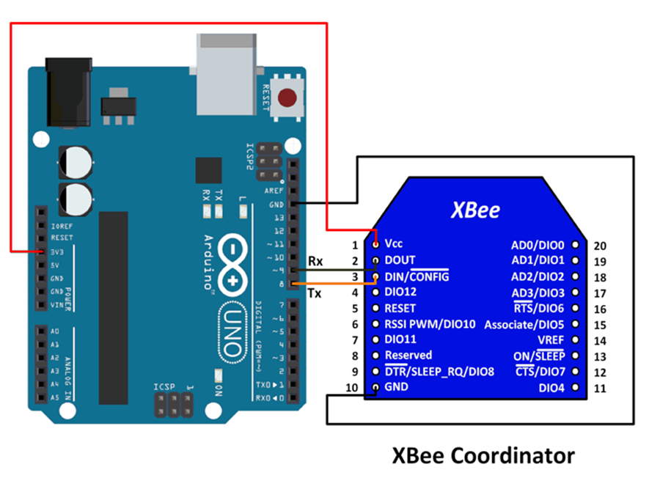
CONNECTIONS

Slide 17
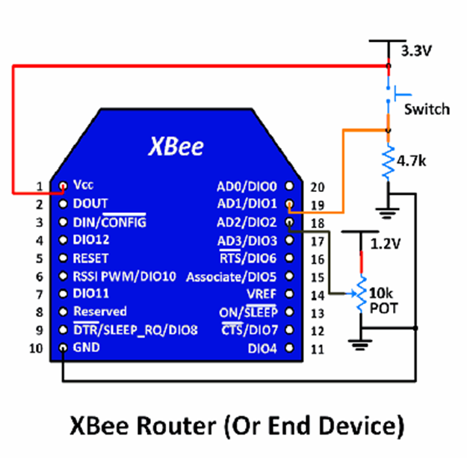

Slide 18
On the transmitting side, the code will be −
#include <SoftwareSerial.h>
SoftwareSerial xbeeSerial(2,3); //RX, TX
void setup()
{
Serial.begin(9600);
xbeeSerial.begin(9600);}
void loop()
{ if(Serial.available() > 0)
{ char input = Serial.read();
xbeeSerial.print(input); }}

Slide 19
As you can see, whatever is sent by the user on the Serial Monitor is sent to the XBee module,and it will be received on the receiving side.
The code for the receiving side is −
#include <SoftwareSerial.h>
SoftwareSerial xbeeSerial(2,3); //RX, TX
void setup()
{ Serial.begin(9600);
xbeeSerial.begin(9600);}
void loop()
{ if(xbeeSerial.available() > 0)
{ char input = xbeeSerial.read();
Serial.print(input); }
}

Slide 20
Kotlin
The Kotlin Mobile app development community is growing very rapidly
Kotlin is a Cross-Platform, Statically typed, General-Purpose Programming language for Java Virtual Machine and JavaScript
Its development team consists of various JetBrains programmers which are based in Russia Feature of Kotlin Interchangeability with Java
Kotlin is anbetter enhancement of Java and the creation of a new class in Kotlin it is very much similar to as of Java
Kotlin is more readable and Understandable, Its syntax is crisp, concise and it reduces lots of unnecessary code that developer writes in Java

Slide 21
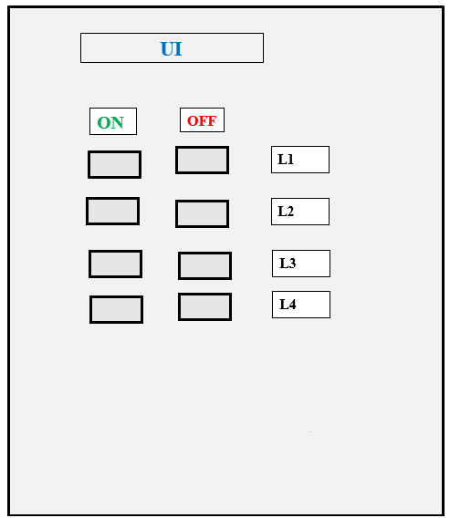
UI

Slide 22
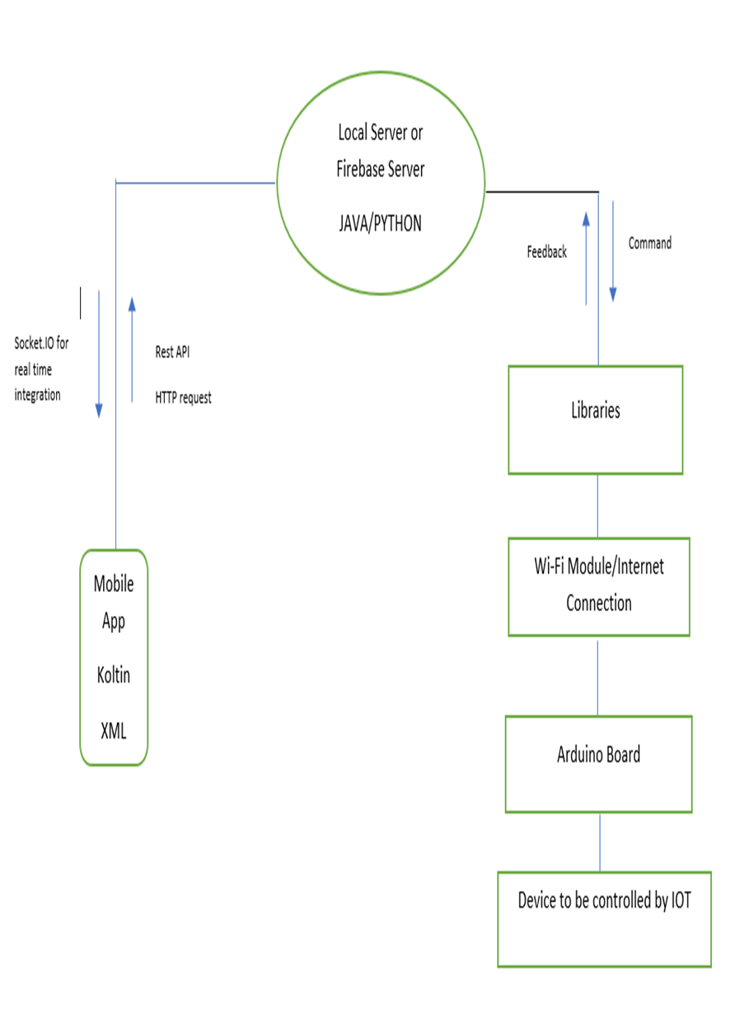

Slide 23
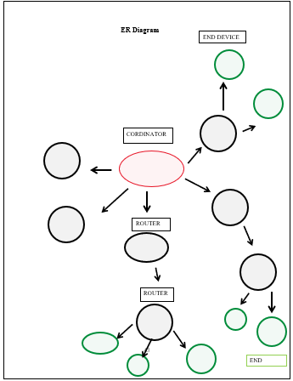

ER diagram

Slide 24
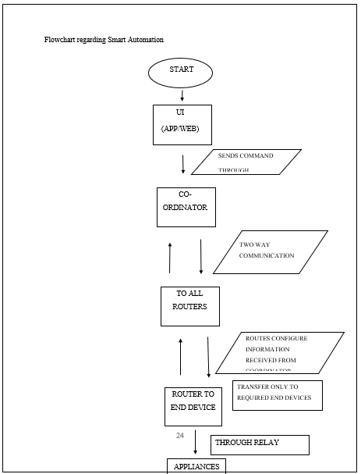
Flowchart

Slide 25
Literature Review
Due to object detection’s close relationship with video analysis and image understanding, it has attracted much research attention in recent years
The proposed object detection is a well-known computer technology connected with computer vision and image processing that focuses on detecting objects or its instances of a certain class in digital images and videos
Another proposed an object detection system finds objects of the real world present either in a digital image or a video, where the object can belong to any class of objects namely humans, cars, etc

Slide 26
Literature Review
This paper presents a review of the various techniques that are used to detect an object, localise an object, categorise an object, extract features, appearance information, and many more, in images and videos
The presented object detection and tracking is one of the critical areas of research due to routine change in motion of object and variation in scene size, occlusions, appearance variations, and ego-motion and illumination changes

Slide 27
Real Time Object Detection and Tracking Using Deep Learning and OpenCV
Since AlexNet has stormed the research world in 2012ImageNet on a large-scale visual recognition challenge, for detection in-depth learning, far exceeding the most traditional methods of artificial vision used in literature
In artificial vision, the neural convolution networks are distinguished in the classification of images
In this paper, an SSD and Mobile Nets based algorithms are implemented for detection and tracking in python environment
Object detection involves detecting region of interest of object from given class of image
Detection and tracking algorithms are described by extracting the features of image and video for security applications

Slide 28
Real Time Object Detection and Tracking Using Deep Learning and OpenCV
Section II describes SSD and Mobile Nets algorithm, section III explains method of implementation, and section IV describes simulation results and analysis
The main objective of Mobile Nets is to optimize the latency while building small neural nets at the same time
Background SubtractionBackground subtraction method is a rapid method of localizing objects in motion from a video captured by a stationary camera

Slide 29
Raspberry Pi as Internet of Things hardware
The Internet of Things – IoT, can be looked as a highly dynamic and radically distributed networked system
In other words, it is a system composed of a very large number of smart objects which are identifiable, able to communicate and to interact, either among themselves, building networks of interconnected objects, or with end-users or other entities in the network
The presence of smart devices able to sense physical phenomena and translate them into a stream of information data, as well as the presence of devices able to trigger actions, maximizes safety, security, comfort, convenience and energy-savings

Slide 30
Raspberry Pi as Internet of Things hardware
Since IoT systems will be designed, managed and used by multiple stakeholders, driven by different business models and various interests, these systems should:· allow new applications to be built on top of existing systems, · allow new systems to be deployed in parallel with existing systems, · allow an adequate level of interoperability, so that innovative and competitive cross-domain systems and applications can be developed
The Raspberry Pi is a small independent computer that runs on the various distribution of Linux operating system and can be programmed as needed

Slide 31
Performance Analysis of XBee ZB Module Based Wireless Sensor Networks
Some of the current applications are environment monitoring, smart metering, logistics, industrial control, smart Agri-culture and to name a few
In the near future, the smart cities and homes will also be incorporated by wireless sensor networks with accessibility to them via the internet
The two main wireless standards mostly used for wireless sensor networks are ZigBee and IEEE 802.15
For this study, we will only analyse the performance analysis of a wireless sensor network using the ZigBee standard
ZigBee is built on top of the IEEE 802.15.4 standard which defines the Medium Access Control and physical layers, operating in an unlicensed band of 2.4 GHz with a data transfer rate of 250 kbps

Slide 32
Performance Analysis of XBee ZB Module Based Wireless Sensor Networks
In terms of networking capability, ZigBee protocol supports three types of communication topologies such as point-to-point, point-to-multipoint and mesh topology
ZigBee enabled devices operate with low duty cycle, hence providing longer battery life which makes it the most widely used devices for a wireless sensor network.ZigBee protocol also features multi-hop communication capability, therefore providing a vast range of communication and a wide coverage area
For instance, ZigBee supports low data rate, and this may make it inadequate for an industrial application which would have a higher requirement in terms of network bandwidth, reliability, scalability and latency than a demotic application

Slide 33
Performance Analysis of XBee ZB Module Based Wireless Sensor Networks
A similar study was also done by researchers in where XBee radio module was used for the evaluation of Body Sensor Networks
Contrary to, we have used the XBee ZB S2 modules which are ZigBee-complaint wireless sensor networking devices developed by Digi International, Inc

Slide 34
Energy Efficient Smart Street Lighting System using IOT
Communications Technology is relatively new inThere are many services in a city which uses electricity that cannot be compromised like hospitals, commercial buildings, public transport but reductions can be greatly done on elements like street lights since public lighting in large Indian cities uses approximately 2% of the total energy consumed and 10-15% of municipal budget

Slide 35
An Analysis of Public REST Web Service APIs
The REST architecture was introduced in the year 2000, by Thomas Fielding, and is based on the principles that support the World Wide Web
In summary, according to the REST principles , REST interfaces rely exclusively on Uniform Resource Identifiers for resource detection and interaction, and usually on the Hypertext Transfer Protocol for message transfer
JSON is more common than XML and the most often used programming languages for implementing the companies’ The study analyzes a certain services niche, while we aim for a broader study

Slide 36
METHODOLOGY
In some cases, the website would provide several web APIs , of which we would randomly select a single one to proceed with the analysis
For APIs with a large number of endpoints we examined a subset design schema used in the URIs the scoping information API versioning support how HTTP method overrides are implemented the use of adequate HTTP status codes in responses
The results show that almost half of the 500 APIs support only one output format, and do not require any kind of output format selection to be performed

Slide 37
I/O and Software Development Support
In this section, we present the results regarding the adoption of basic security mechanisms by the web APIs , namely user authentication mechanisms and SSL/TLS encryption support
Most APIs require some form of service registration for developers to start using the API
APIs are often used in applications, with the majority hardly being used

Slide 38
THREATS TO VALIDITY
Regarding internal validity, it is relevant to point out that we verified a subset of the available endpoints in the case of
APIs providing a large number of endpoints, as it was unfeasible to verify all

Slide 39
REFERENCES
D. Miorandi et al., "Internet of things: Vision, applications and research
challenges," Ad Hoc Networks 10 (2012) 1497–1516
A.K. Dennis, Raspberry Pi Home Automation with Arduino, Packt
Publishing, USA, 2013
D. Uckelmann, M. Harrison, F. Michahelles, Architecting the Internet of
Things, Springer 2011
J. Kopecký, P. Fremantle, and R. Boakes, “A history and future of
We b A P Is ,” It - Inf. Technol., vol. 56, 2014.
R. T. Fielding, “Architectural Styles and the Design of Network-
based Software Architectures,” Univ. of California, Irvine, 2000.
R. Battle and E. Benson, “Bridging the semantic Web and Web 2.0
with Representational State Transfer (REST),” We b Se ma n t. Sc i .
Serv. Agents World Wide Web, vol. 6, no. 1, pp. 61–69, Feb. 2008.

